Slide 1
Cultivating Gratitude for Your Wellbeing
Dr. Stacey Elliott
Safety Net Behavioral Health Medical Director
Anna D’Amico
Manager, Organizational Development. Certified Yoga & Meditation Teacher RYT 200

Slide 2
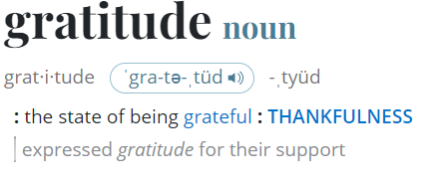
Source: Merriam-Webster
Notes:
What is gratitude? It’s more that saying thank you, it’s a way of seeing the world. It is not simply something felt in response to something you have been given or earn, such as being thankful. Gratitude is a much deeper way of living that comes from an awareness of being in the moment.
Gratitude is subjective it’s the appreciation of what is valuable and meaningful to oneself.
practical clinical definition is as follows—gratitude is the appreciation of what is valuable and meaningful to oneself; it is a general state of thankfulness and/or appreciation. Gratitude and Well Being - PMC (nih.gov)
Gratitude is a powerful human emotion. By conveying and receiving simple ‘thank you’ messages, we can truly derive the pleasure that we seek everywhere else. Gratitude, derived from the Latin word ‘gratia,’ means gratefulness or thankfulness.
In its simplest form, gratitude refers to a ‘state of thankfulness’ or a ‘state of being grateful’.
Gratitude is more than just a momentary good feeling. Scientists who have studied written gratitude interventions, such as gratitude letters or journals, have found benefits for an individual’s mental health and well-being. Gratitude practices also appear to help you feel more satisfied in life and can boost your self-esteem, according to peer-reviewed research.

Slide 3
Gratitude is a positive emotion felt after being the beneficiary of some sort of gift. It is also a social emotion directed towards a person (the giver of a gift) or felt towards a higher power, fate or the natural world.
Notes:
What is Gratitude and Why Is It So Important? (positivepsychology.com)
Robert Emmons, professor of psychology at the University of California, Davis, and one of the world’s leading experts on the science of gratitude, defines gratitude as having two parts. The first is an affirmation of goodness: People can learn to wake up to the good around them and notice the gifts they have received. The second part of gratitude is recognizing that the source of this goodness rests outside of oneself—that we receive these gifts from other people, and sometimes from a higher power, fate, or the natural world. In other words, gratitude helps people realize that they wouldn’t be where they are without the help of others.
Positive Psychology sums up the psychological, social and religious meaning of this positive emotion

Slide 4
Continuum of gratitude lens
Less
More
Orientation:
Life as a burden
Dissatisfied
Deprivation mindset
Orientation:
Life as a gift
Satisfaction
Abundance mindset
Notes:
Robert Emmons: The Power of Gratitude – YouTube
It’s impossible to appreciate what we have when we are in a constant state of wanting, nothing is ever enough. Think of gratitude as a being on this continuum where there are different levels of gratitude from someone who has a short-term feeling of gratitude (which is powerful) to a grateful person who habitually practices gratitude looking at life through a gratitude lens. “We can align levels of gratitude on a continuum from the habit of saying thank you to a deep, abiding sense of thankfulness for life as a fundamental life orientation.” Robert Emmons
Goal is to get people to that place of gratefulness as a way of life because of the benefits it can provide. People at this end of the continuum accept all life as a gift. (can be different than all the nice things happening to you but have to start somewhere)
Being grateful produces positive feelings and leads to doing good for others. Grateful people are happier and more satisfied, but they tend to do good things as well. They live life giving with acts of generosity and compassion; more forgiving; more pro-social (generous, kind, helpful).
Unusual to find ungrateful people, we usually return good with good, not harm. But there are those that have a different orientation toward life, maybe focused on what life is denying them, what they’re losing out on; looking at life from a lens of scarcity or deprivation vs. abundance.
Many fall in between these extremes. Even grateful people have times when they feel deprived, and feel injustices are being committed against them.
We see the effects of gratitude because of the positive mindset or outlook. Grateful people – positive orientation toward self, others and the world (positive triad) – which in general leads to positive functional outcomes.

Slide 5
Source: Positivepsychology.com
Notes:
It’s those on the grateful end of the continuum, that view life from a gratitude lens that realize the most psychological, social and physical benefits. It can have many psychological, physical and social benefits.
The Neuroscience of Gratitude and Effects on the Brain (positivepsychology.com)
https://youtu.be/bVycTYDd42M
“We hear a lot about gratitude these days but in the culture of always wanting more, the experience of gratitude may be difficult to achieve since often we focus on what is missing in our lives. If we spend deliberate time focusing on what is right and what is good, our habit of negativity can weaken, and our appreciation can strengthen”
Merely stating “thank you” is not enough to practice the state that improves wellbeing (connective gratitude).

Slide 6
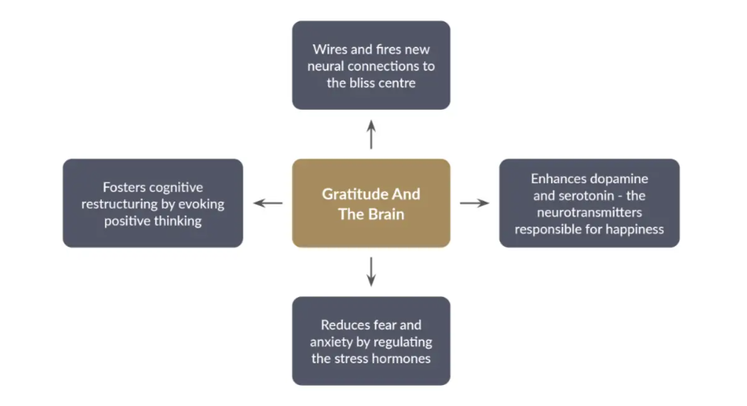
Your brain on gratitude
Source: Positivepsychology.com
Notes:
From Jay Shetty (on Calm): We know that gratitude just feels good. That’s because it affects our neuropathways, our mind and body in a unique way. Neuroscientist at UCLA, Alex Korb – he says it’s nearly impossible to focus on negative and positive feelings at the same time. Practicing gratitude. can keep us moving toward the positive. practicing gratitude allows our brains to release serotonin and dopamine—two “feel good” chemicals that positively impact mood, willpower, and motivation. But what’s not as well known is regularly engaging in a gratitude practice strengthens these neural pathways. Over time, practicing gratitude will “train” your brain to focus on what’s going well versus what isn’t. And that leads to all sorts of positive outcomes—mental and physical. One study of nurses found that gratitude consistently predicted less exhaustion, fewer sick days, and higher job satisfaction.
It’s not always easy to access gratitude. Some of us might naturally have obvious things to be grateful for, at least it appears externally. But we all can choose gratitude. It is a choice.
Gratitude – natural anti-depressant – daily journal experiment.
https://chopra.com/articles/the-neuroscience-behind-gratitude-how-does-cultivating-appreciation-affect-your-brain
The effects of gratitude, when practiced daily, can mimic the effects of antidepressant medications. It produces a feeling of long-lasting happiness and contentment, the physiological basis of which lies at the neurotransmitter level.
When we express gratitude and receive the same, our brain releases dopamine and serotonin, the two crucial neurotransmitters responsible for our emotions, and they make us feel ‘good’. They enhance our mood immediately, making us feel happy from the inside.
By consciously practicing gratitude everyday, we can help these neural pathways to strengthen themselves and ultimately create a permanent grateful and positive nature within ourselves.

Slide 7
Steps to cultivating gratitude
Reflect
Recognize challenges
Practice
Notes:
Gratitude is a lifestyle, and practicing builds the mental muscles that show up as positive emotions.

Slide 8
Reflect
Do you feel like you have a lot to be thankful for in your life?
If you made a list of all the things you are grateful for, would that list be very long?
When you look at the world, can you find many things to be grateful for?
Do you feel like your appreciation for life and other people has grown stronger as you get older?
Do you frequently experience moments where you appreciate someone or something?
Do you appreciate a wide variety of people in your life?
Notes:
You can evaluate your tendency to experience gratitude by asking yourself the following questions.
If you answered yes to most of these questions, you probably have a strong sense of gratitude. If you answered no to many or all, you could take steps to bring more gratitude into your life.
Source: https://doi.org/10.3389/fpsyg.2017.01498

Slide 9
Recognize challenges
Negativity bias
Cultural influences
Lack and wanting
Comparison and envy
Expectations
Automaticity
Notes:
The field of psychology has found that everyone seems to have a set point for happiness. We all know someone with a permanent disposition for happiness. And then there are the scrooges or Eeyores of the year. This is not meant to be judgmental but to understand that we all have a pre-determined set point for happiness influence by a combination of factors including our genes, our biochemistry, and the circumstances into which we were born. This is why being rich, famous or even winning the lottery doesn’t necessarily increase our experience of happiness for long. Study (Emmons) – lottery vs spinal cord injury group. Lotter winners not as happy as expected and injury group more expected. Even with pivotal events, people return to their natural level.
If we practice gratitude consistently and intentionally, our baseline can grow and we can change our set point.
Negativity bias – As a survival mechanism the human brain has evolved a tendency to focus on negative information over positive information. We naturally turn toward negative. Rick Hansen, psychologist the mind is like Velcro for negative experiences and like Teflon for positive ones. An act of kindness can be forgotten but the painful memory of an argument, failure, embarrassment can stick for a lifetime. We can rewire our brains to strengthen positive information and emotions. Neurons that fire together, wire together. The more we have a certain type of thought, the stronger that tendency grows in our brain. Can you see any patterns of negative thoughts or emotions that might block you from tapping into gratitude? Has negativity become a habit for you in a particular way, like complaining, or ruminating on the same regret over and over?
Cultural influences - We’re inundated with messages and images that can condition us to be dissatisfied with our lives, through advertising, entertainment, and social media. What effect do these influences have on you? Do you have any fixations on things that will one day “fix” your life, or any judgements about what’s wrong with your life today?
Lack and wanting - We all desire things in life, but do you have ambitions or aspirations that might be unhealthy or ineffective? Do any of your desires cause you to feel unhappy with your life as it is today? Are you convinced that a future accomplishment will fill a void you see in your life?
Comparison and envy - Do you fall into this pattern? Are there specific people who trigger this tendency, or does it stimulate dissatisfaction with a particular part of your life? Does your use of social media fuel these emotional patterns?
Expectations - Are there ways you could challenge your expectations? Could this help you find satisfaction in your life as it is today, irrespective of how you once thought it was supposed to unfold?
Automaticity - Are you sometimes so busy and rushed that you aren’t mindful of the everyday blessings of life? Are there particular routines or times of day when you slip into this pattern?

Slide 10
“It is not happiness that brings us gratitude. It is gratitude that brings us happiness.”
Notes:
Gratitude is a choice that take practice. Let’s look at some of the ways to practice.
Jay Shetty - when you are in gratitude, you can’t be anywhere else

Slide 11
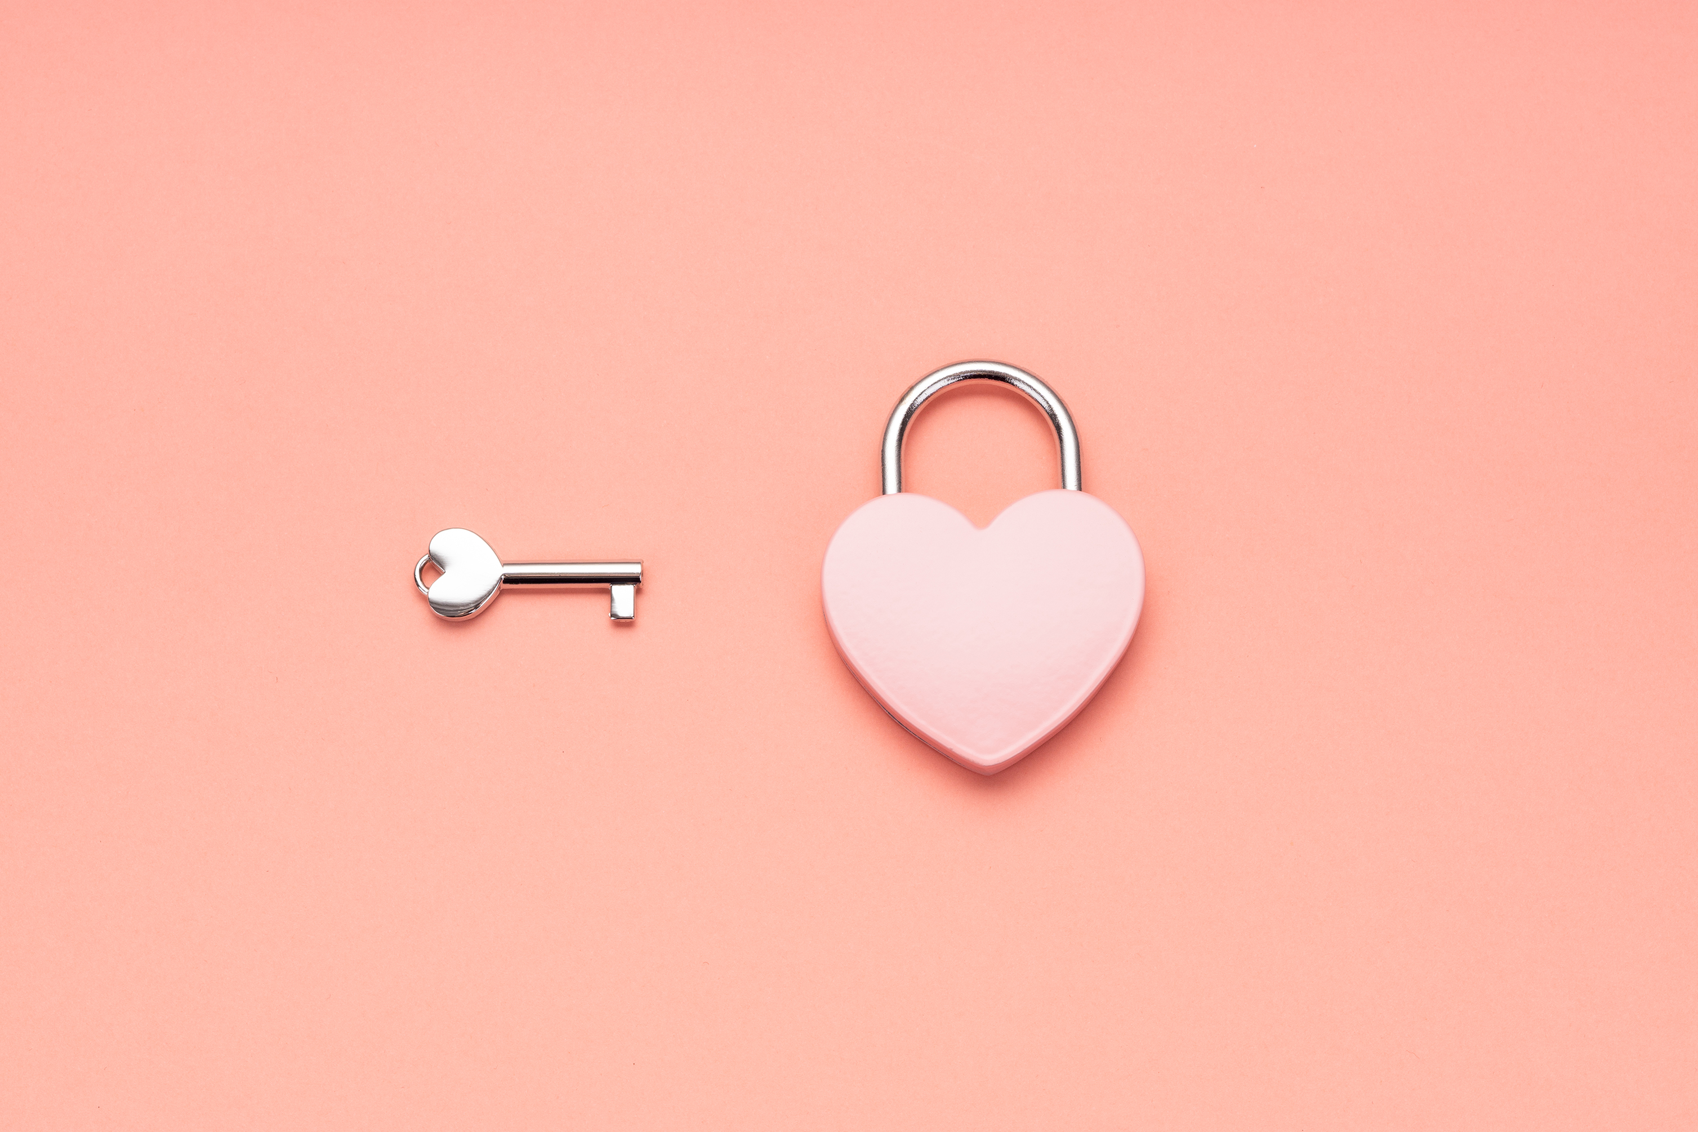
Practice Consistency is key
Before you get out of bed, think of one thing you’re grateful for
Gratitude journal/list – start with 3 things
Be mindful and savor your experience
Write a letter to yourself or someone else
Create a gratitude box/jar
Gratitude notes/recognition system
Meditation
Yes, and…
Make a visit
Say thank you in a sincere and meaningful way
Notes:
Consistency is key
Practicing Gratitude | NIH News in Health
Journal - According to Robert Emmons, the world's leading scientific expert on gratitude, people are 25 percent happier if they keep gratitude journals; that those who keep gratitude journals also sleep one half hour more per evening, and exercise 33 percent more each week compared to those who don’t keep journals. – Take a moment to think about the positive things that happened during the day; make a habit of writing down things you’re grateful for. Try listing several things. Be specific, i.e. I’m grateful for my dog because she loves me unconditionally and make me laugh
Be mindful and savor your experience – try to notice positive moments as they are happening.
Relive the good times. Relive positive moments later by thinking about them or sharing them with others.
Write to self/someone – write a letter to someone you feel thankful toward. You don’t have to send it, just the act of writing it makes a difference; Write a letter to your past self in appreciation for all of the fantastic actions and decisions you’ve made that are benefitting you today.
Create a gratitude box/jar – a physical container where you store grateful memories. The idea is to write something down you are thankful for and place it in the box. When you are felling sadness or struggling, reach inside and read one of your notes to be reminded of what you have to be grateful for.
Gratitude notes/recognition system
Find a gratitude buddy
Yes, and… - This exercise can help challenge the habit of complaining. This is a trick to reframe a negative thought. Every time we catch ourselves in a complaint, we can “Yes, and” in order to flip a negative observation into a positive one: “Great, my friend is 20 minutes late for our coffee meeting. Yes, and now I have an opportunity to call a friend”; I’m disappointed that my weekend plans were cancelled at the last minute. Yes, and I’ll take this opportunity to spend time with my nephew and give my sister a break.”; “Ugh, I have to spend my Saturday sick in bed. Yes, and at least I have an excuse to catch up on my favorite Netflix show.”’
With Thanksgiving next week, perfect time to:
Make a visit – tell someone you’re grateful for them as a person
Say thank you - This exercise is one of the most ancient practices in all of human history: The simple act of saying “Thank you.” We may say thank you as an automatic reaction many times during the day. The challenge isn’t just to say it, but to feel it, and to convey that appreciation. Example – thank you for coming to my party changes to thank you for spending time with me last night. I really enjoyed our catching up and having fun together. It meant a lot to me!

Slide 12
Gratitude at work
Write a handwritten thank-you card
Find a gratitude buddy
Practice Gratitude countdown with others
Start a meeting with what has gone well
Create a team word cloud
Appreciate and recognize others’
contributions and accomplishments
Notes:
these actions support our value and behaviors of we care about our wellbeing.

Slide 13
Layers of gratitude
Passively grateful and not often thing about it or what it can do. Saying thank you on autopilot (still can be powerful)
Being aware and adopting a mindfulness practice, seeking out things/ways to be grateful
Consistently practicing and gratitude is hard wired in brain so one is in a perpetual state of gratitude
You no longer need something or someone to create the feeling of gratitude, you just are
Notes:
Practicing will deepen your level of gratitude which will in turn provide more benefits.
There are layers and levels of practicing gratitude and techniques that go beyond the basic
Level 1 - passively grateful and not often thinking about gratitude, or aware of what it can do. It comes when it comes.
Level 2 - awareness and adopting a mindfulness practice of seeking out things to be grateful for. Taking time each day to write down 3 things to be grateful for.
Level 3 - Gratitude becomes hard wired in the brain, a perpetual state of gratitude.
Level 4 - this is where you no longer need 'something' or 'someone' to create the feeling of gratitude. You just are.

Slide 14
“Enjoy the little things. For one day you may look back and realize they were the big things.”
- Robert Brault

Slide 15
Gratitude: A daily Mindfulness Practice Real-life mindfulness practice that can make a difference in your day

Slide 16
Mindfulness: Did you know?
You have approximately one thought every 1.2 seconds (you will not stop them so don’t even try! They are not interruptions in your day, they are part of it. Let them come and let them go and simply come back to your breath)
The term Stress is short for the word Distress a word evolved from the Latin Term “stringere” meaning to draw tight or pull apart ( at work it can feel like you are being pulled in a million directions pulling us away from our basic needs -one of those needs being our breath
When we are pulled away from our most basic needs, we become harsh or impatient, defensive, reactive, overwhelmed, unclear ( cortisol stress hormone rises) forget what and who we are grateful for

Slide 17
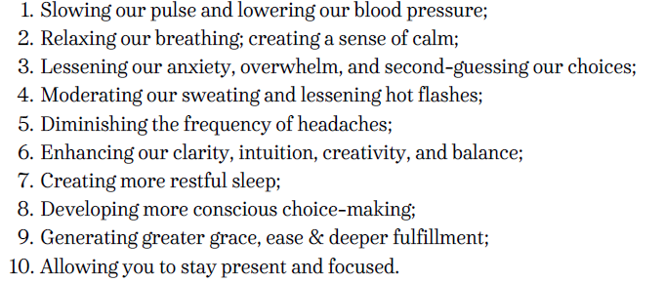
Mindfulness through practicing Gratitude has scientifically proven to counteract the effect of stress by:
If the definition of stress is how we respond to our needs not being met…
Mindfulness about gratitude can be the antidote to stress!

Slide 18
Benefits in the Workplace:
Creating a State of Awareness- more present in meetings
Increased patience
Increased ability to actively listen
Increased ability to respond vs. React

Slide 19
Gratitude: Let’s Practice!

Slide 20
Practice Gratitude Daily:
What Am I Grateful for today?
Who Am I Grateful for today?
How do I feel when I think about this list?

