Slide 1
RRHIMA 2022-2023 Highlights and Business Meeting
May 4, 2023

Slide 2
RRHIMA 2022-2023 Board of Directors
President Mary Pasciak, RHIT
President-Elect Penny Hankins, MS, RHIT
Past-President Lynn-Marie Wozniak, MS, RHIT, CDIP, FAHIMA
Director of Bylaws Katie McKibben, RHIT
Director of Communications Diana Visconte, RHIT, CHC
2nd Yr Director of Education Leslie Slater, MS, RHIA, CCDS, CIC, CRC
1st Yr Director of Education Beth Ann, Hinog MSHIA, RHIA
Director of Finance Brandy Almekinder, RHIT
Student Representative Marina, Caito – Alfred State Student

Slide 3
Updated Mission and Vision Statements
Mission:
The Rochester Regional Health Information Management Association promotes professional excellence and provides growth opportunities for its members through education, volunteering, recruiting, and mentoring.
Vision:
To be the recognized association and recognized experts in the management of health information in the region.

Slide 4
2022 – 2023 Accomplishments
Increased membership from 93 to 111 dues paying and emeritus members
Stayed within our Budget (Revenue = Expenses)
Held annual picnic in August
Updated strategic plan for 2022-2023
Updated Bylaws and Procedure Manual
Retired Bylaw Director position and replaced with Director of Membership Engagement
Held successful webinar series in Fall and Spring
Held 3 Coders SIG Meetings (Oct, Dec & May)
Held quarterly LTC SIG Meetings
Conducted a fun online HIP week
Held a successful in-person annual meeting
Elected a new BOD for 2023-2024

Slide 5
Strategic Plan for 2022-2023
Leadership Development
Ensure RRHIMA always has a pool of qualified and eligible members to choose from the BOD
Provide opportunities for members to develop leadership
Governance
Build and sustain a strong infrastructure to support RRHIMA operations
Ensure sustainability, continuity, and consistency of RRHIMA

Slide 6
Strategic Plan 2022
Education
Provide cost effective educational programs that meet AHIMA core content areas and expanding roles
Offer a minimum of 15 CEUs per association year
Membership Growth & Engagement
Grow membership and engage members through volunteer, mentoring, and networking opportunities
Increase membership
Increase online presence and utilization of online vehicles to promote member engagement in RRHIMA activities
Hold at least two social/networking events each year
Hold three business meetings in conjunction with education sessions or other RRHIMA events
Create and promote opportunities for members to volunteer
Survey members to find out what they want and need from RRHIMA at least once a year

Slide 7
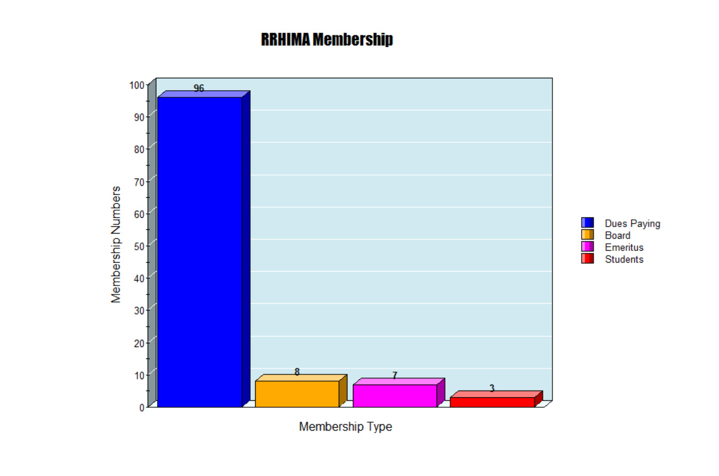
AHIMA Membership –
114 Members

Slide 8
2022-2023 RRHIMA Bylaw Changes
Eliminated Director of Bylaws position, replaced it with Director of Membership Engagement
Amended the time and location requirements for both regular board meetings and business meetings. These meetings can now be held both face-to-face or by electronic means, and there is no required set duration for meetings (e.g. strategic planning meeting). This allows for more flexibility in conducting business as a board.
Moved the responsibilities of the Bylaws Director to the Past President.

Slide 9
2022-2023 RRHIMA Bylaw Changes Continued
Changed how RRHIMA gives notice of proposed bylaw changes to the members to include both written and electronic means.
Changed the title of Article VIII from “Special Interest Groups and Standing Committees” to “Special Interest Groups and Committees” to be more inclusive of what is actually addressed in the article.
Specified who is eligible to be a SIG facilitator, how they are appointed, and the term of their appointment. A SIG facilitator must be a dues paying or emeritus member of RRHIMA, and will be (re)appointed annually by the board of directors.

Slide 10
2022-2023 RRHIMA Bylaw Changes Continued
We specified who is eligible to be a committee chair of a standing committee, how they are appointed, and the term of their appointment. Our current standing committees in the association include Membership, Education, and Strategic Planning, and can only be chaired by a dues paying or emeritus member, and are appointed by the board of directors.
Lastly, our dues increased from $20 to $25 in order to cover administrative fees such as Zoom, Paypal fees and shared file storage.

Slide 11
RRHIMA Procedure Manual Updates
2022-2023 Procedure Manual Updates Include:
A yearly calendar, organized by month and board position, outlining the tasks needing to be completed each month by each board member. This will allow any future incoming board members to have a smoother transition into their duties and responsibilities on the board, as well as a clear picture of upcoming future duties and events.
The manual is undergoing a format change to the “Google Docs” format from a PDF. This is to facilitate ease of navigation and future updates to the manual.

Slide 12
Communications Report
Spotlight articles – we have posted on our RRHIMA website four Spotlight articles to highlight our HIP professionals.
Donna Barnard, RHIA URMC Director of HIM
Ann Ortolaza, RHIT RRH Outpatient Coder
Lorri Lauzze RRH Compliance Director
Katie McKibben,RHIT URMC Outpatient Coder
Facebook activity – been posting a lot of event information, holiday posts, webinars, SIGs, sharing posts from NYHIMA and AHIMA.
Linkedin activity - New this year - Have been posting on linkedin to expand our membership and to start conversations with other HIP professionals.
Email efforts – have sent out several emails promoting RRHIMA events, webinars, AHIMA efforts, SIGs, etc. Check daily to keep in touch with membership.
RRHIMA Website – online membership application, “Members Only” section available via UN/PW, member directory, job opportunities, videos, forums, event calendar (available to public), news (available to public), etc.

Slide 13
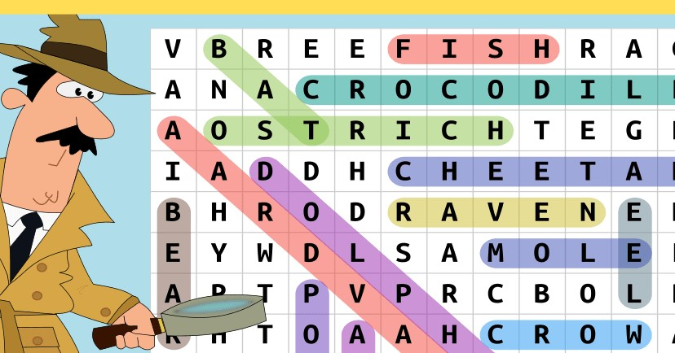
HIP Week - April 17, 2023 -April 21, 2023
Games
Over 45 people participated
Winners
1st place: RRHIMA Web Series Voucher - Anjali Sharma
2nd place: $20 RRHIMA Membership Voucher - Michelle Tortatice
3rd place: RRHIMA t-shirt-Barbara Sigouin
Highlights
3 members were highlighted during HIP Week
Chelsea Vasta
Ed Patrick
Denise Camuto

Slide 14
Education
2022 Fall Webinar Series
09/22/22 Advancing HealthCare Equality in the Minority Community
09/27/22 Advancing Health Care Equity in the Workplace
10/11/22 Racial Disparities in Cancer Related Conditions & Treatment in the Rochester Area
11/10/22 Emotional Intelligence & Impact on Workplace Relationships
11/22/22 Health Literacy Webinar
12/01/22 Community health Assessment and Improvement Plan
6 AHIMA/AAPC CEU. $45/member $65/non-member
49 registrants for the series
Resulting in 240 attendees over the 6 sessions
Attendance at each webinar ranged between 24-38 with an additional 59 YouTube views
Topics, speakers and information well-received by attendees

Slide 15
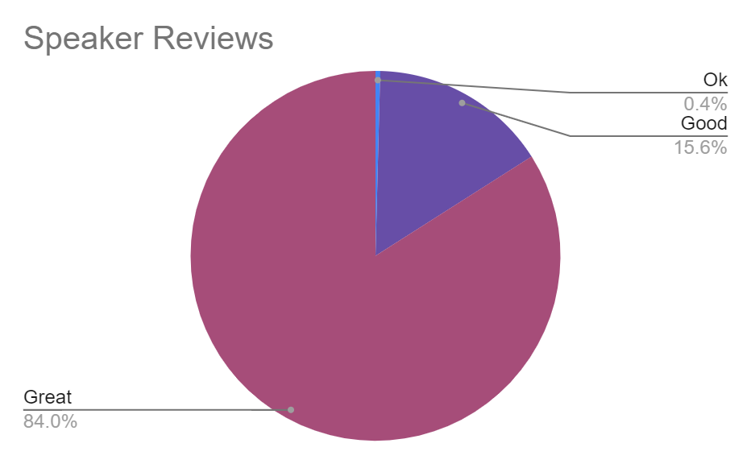
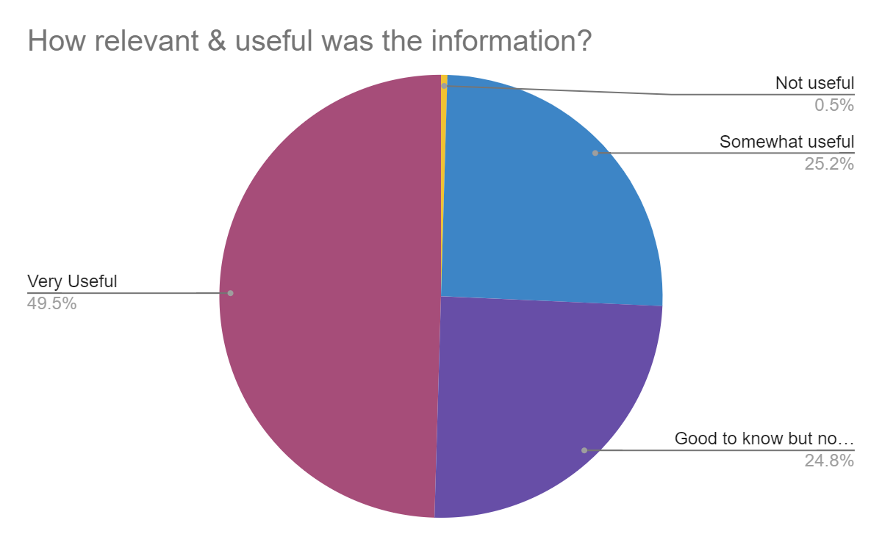
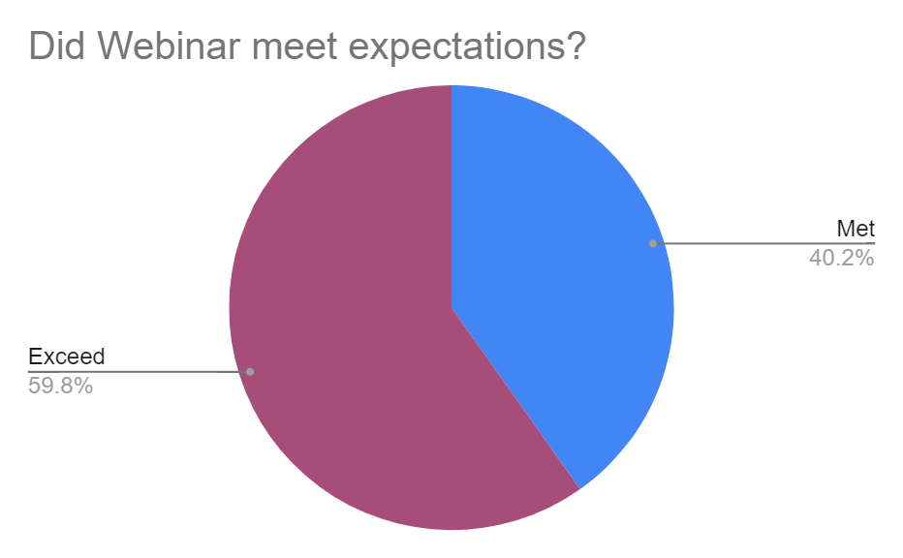
Education Report:
2022 Fall Webinar Series
Participate Comments:
This is another great topic that I would love to learn more about and continue to see educational webinars on in the future. Thanks!
RRHIMA continues to set the bar high for education offerings.
This was probably my favorite webinar- everyone should be taught emotional intelligence- great pick
Dr. Cuyler was an excellent speaker. Her presentation was very informative and interesting to listen to. I really enjoyed it.

Slide 16
Education:
2023 Spring Webinar Series
2/16/23 PDPM Overview: Presenter: Chris Hoskins, MA, RHIA, CHC
2/23/23 Home Health Services: Documentation Requirements in PGDM World: Presenter: Karen Donovan, RN
03/02/23 IVR Peripheral Interventions: Presenter: Jackie Carver, RHIA, CCS, CCSP
03/16/23 OPPS & MPFS 2023 Final Rule: Presenters: Jean Russell, RHIT and Veronica Ziac, MBA
4/13/23 Overview of Risk Adjustments and HCC Coding: Presenters: Melissa Rector CRC
04/20/23 Common & Complex Inpatient Denials: Presenter: Sandra Macica, MS, RHIA, CCS
6 AHIMA/AAPC CEU $50/member $70/non-member
Notes:
Spring Webinar Series “Many Facets of Coding” explored various coding and reimbursement topics.

Slide 17
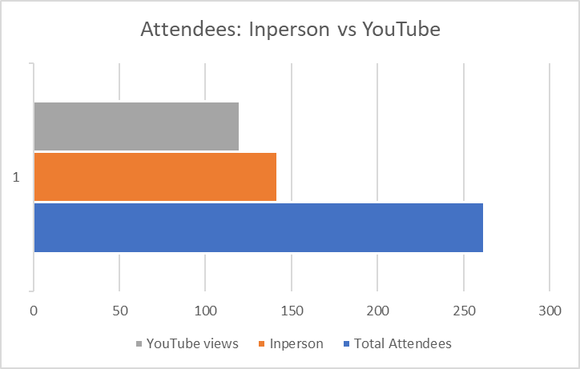
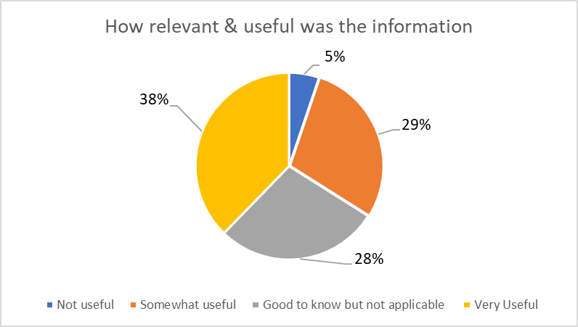
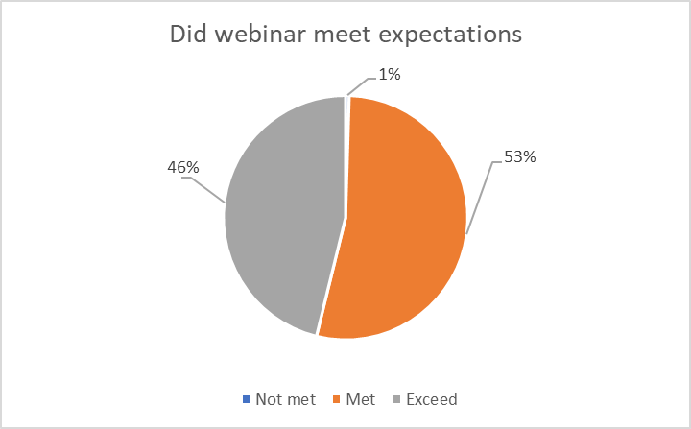
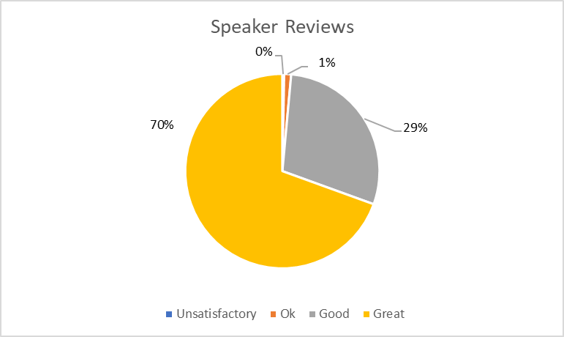
Education - Spring 2023 continued
Quick Stats:
262 attendees over the 6 sessions
Attendance for each session ranged between 22 and 26 people
120 YouTube views
Topics, speakers and information well-received by attendees
Notes:
The data represented here was aggregated from the responses submitted via the individual evaluation forms from each of the six webinars offered to members.

Slide 18
Special Interest Groups (SIGs)
Coders SIG
Met 3 times this year via Zoom. Free to attend.
All RRHIMA Dues Paying and Emeritus members get 1.0 AHIMA/AAPC CEU for attending.
This year’s meetings were:
Oct 5, 2022 - ICD-10-CM Update for FY2023 - Donna Rugg, RHIT, CCS, CDIP
Dec 7, 2022 - E/M Code & Guidelines 2023 Update - Diana Visconte, RHIT, CHC & Jessica Maciulis, COC, CHC
May 18, 2023 - ED Coding - What it Entails and How it is Done - Rachael Richenberg, RHIT and Angela Havranek
LTC SIG
Meets quarterly via Zoom. Meeting dates and times posted on RRHIMA website.
Free to attend. CE granted to RRHIMA dues paying and emeritus members.
Newcomers SIG
Met during the summer to help new grads prepare for RHIT exam
Will relaunch in the upcoming year as the Professional Development SIG.

Slide 19
Finance
RRHIMA Membership Form
We removed the automatic renewal option from the membership form in Sept, 2022. We would like you to fill out the membership form yearly to keep your information up-to-date and we want to stay away from automatic renewals, because we had several people that signed up twice last year and got charged twice. We are going to delete our current PayPal account soon to sever any remaining automatic renewals for RRHIMA dues. We will then create a brand new PayPal account.
The membership form will be taken down from the website for several weeks before the new year begins on July 1 and then it will reappear and it will be connected to our new PayPal account.
As I mentioned, you must always fill out the membership form every year and if you pay your dues through PayPal when filling out the form please do not choose automatic renewal or subscription when you are within PayPal. The membership form is the only way you can pay your dues to RRHIMA. YOU CANNOT PAY YOUR DUES USING THE PAYPAL LINK, YOU MUST USE THE MEMBERSHIP FORM.

Slide 20
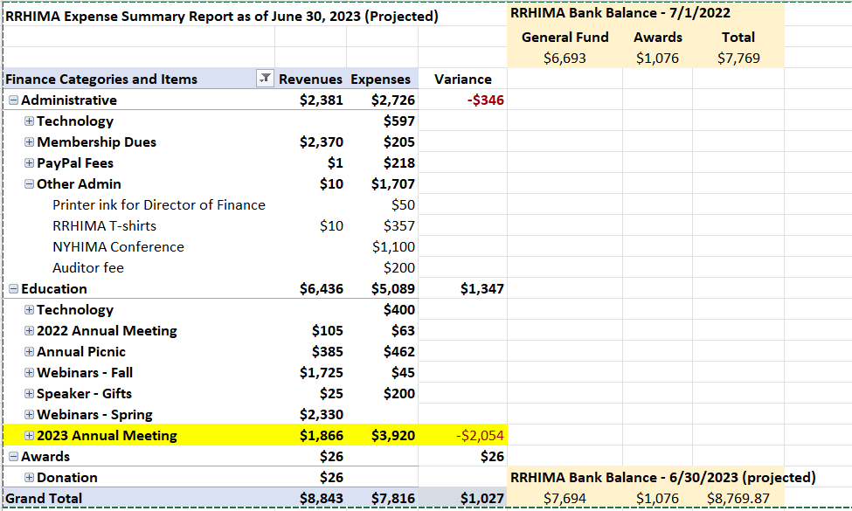
Finance - Expense/Revenue Summary

Slide 21
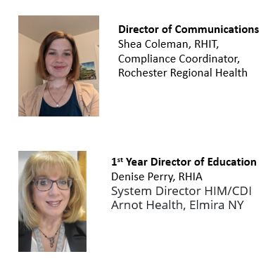
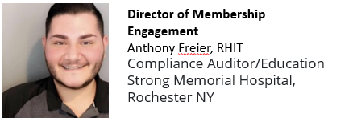
Election Results
THANK YOU to Lisa Boyle for volunteering to run for the Director of Membeship Engagement our new board position. It was a close race and we appreciate her participation.

Slide 22
RRHIMA Annual August Picnic
Date: Thursday in August, 30, 2022 4:00 - 7:30 PM
Where: Mendon Ponds Park - Stewart Lodge
95 Douglas Road, Honeoye Falls, NY
We had a great speaker - Dr. Asli Abaci, MD from Excellus BlueCross BlueShield
Dr. Abaci presented a powerpoint on “Media Impact on Mental Health”. It was a great presentation.
We offered 1 CE to all who attended. We had door prizes which we gave away including bouquets of fresh flowers, that were created by Beth Hinog, Education Director and Mary Pasciak, President. We had great food, fun and a great time to socialize. Unfortunately, the weather was inclimate, and we all stayed inside the lodge.

Slide 23
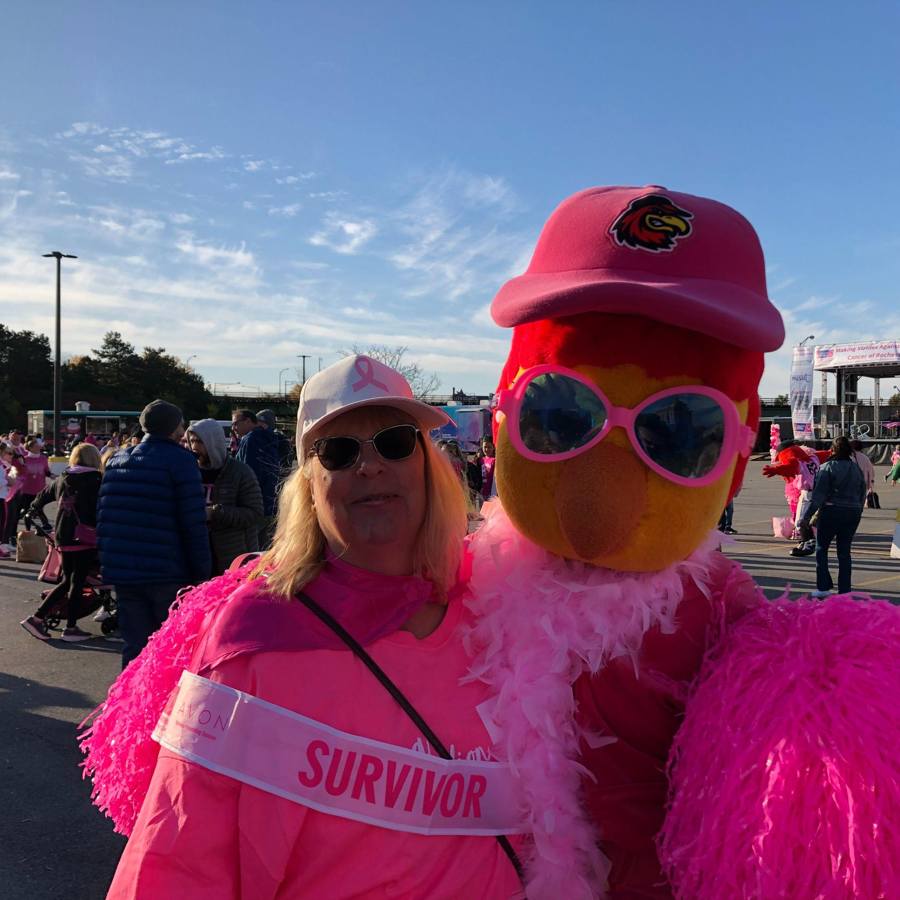
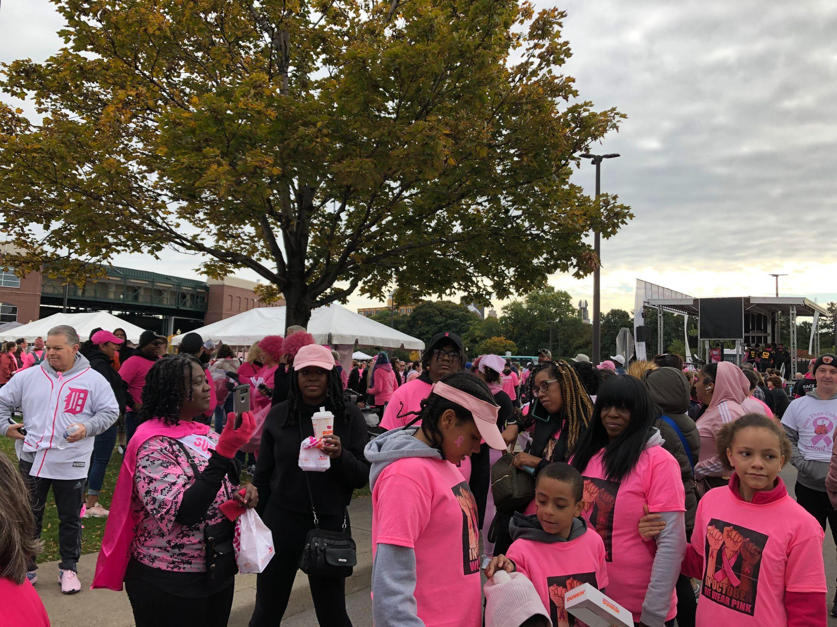
Breast Cancer Walk
The Breast Cancer Walk was held on Sunday October 16, 2022 from 8:30 am to 1:00 pm and the walk was 2 miles long. The walk started at Frontier Field in downtown Rochester NY. There ware 8000 walkers from all healthcare organizations. An estimated $33,000 was raised. Beth and Mary Pasciak had a great time and met many wonderful people.

Slide 24
ALFRED STATE HIM STUDENTS
AHIMA Board of Directors would like to thank Lisa M. Boyle - Alfred State HIM Professor, Erica S. Matteson, Alfred State Student Advisor and Marina Caito RRHIMA Student Representative for helping us stay connected with the students of Alfred State.

Slide 25
Questions?

Slide 26
Thank you for attending!

